Slide 1
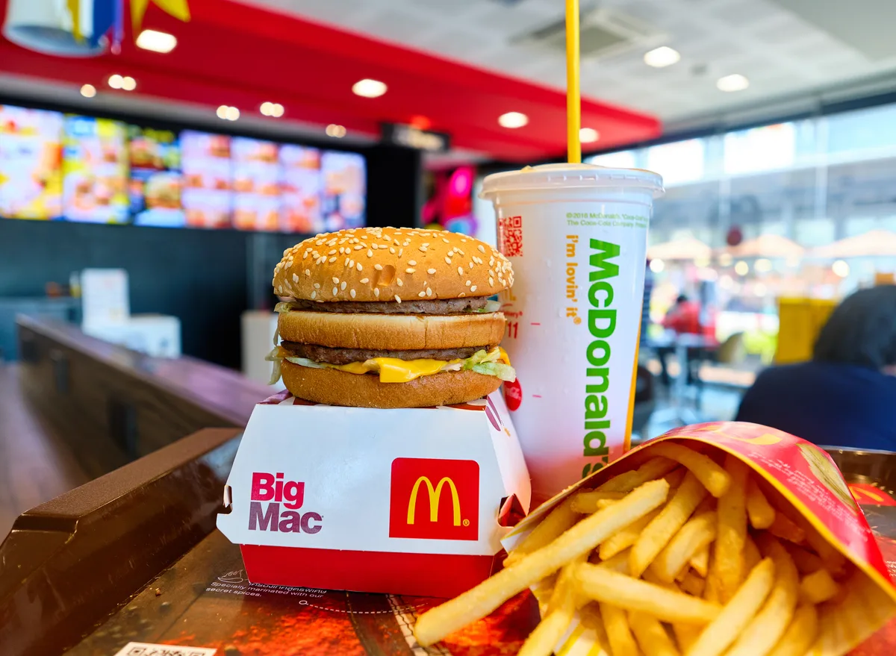
McDonald’s Market Analysis
By
Utkarsh Sinha

Slide 2
Problem Statement: McDonald's needs to develop an effective market segmentation strategy to target specific consumer segments and improve their perception and preference for the brand.
Objective: The objective of this case study is to identify and analyze distinct market segments within McDonald's consumer base, understand their characteristics and preferences, and develop a customized marketing mix to cater to the needs and preferences of the selected target segment. Additionally, the objective is to continuously evaluate and monitor the effectiveness of the market segmentation strategy to ensure its relevance and success in the dynamic market environment.

Slide 3
Introduction
McDonalds Corporation is the world’s number 1 fast food chain, Richard and Maurice McDonald started this business with a restaurant in San Bernardino California in 1940. Now a days McDonalds serving more then 56 million customers every day.
There are more then 30,000 restaurants operated by McDonalds worldwide in which more then 80% are operated as franchise and less then 20% are owned by company.
McDonald’s main selling products are hamburgers, cheeseburgers, double cheeseburgers, big Mac burgers, quarter pond burgers, tasty burgers, flit-o-fish burgers, salad and fruits.

Slide 4
Company profile
McDonalds is the words largest fast food corporation, serving more then 57 million people in 119 countries daily with more then 31,000 restaurants world wide in which 6,899 are owned by company and 20,499 are operated as franchise and 3,960 are operated by affiliates.
McDonalds employing more then 1.5 million people worldwide, only in UK Company owned restaurant employed 43,492 in 2004 in which hourly paid employers are 2,292. 2,291 restaurant management and office staff nearly 500. and nearly 25,000 people employed in franchises.
In 2003 McDonalds owned donates pizza, McDonalds owned a majority of stake in chipotle Mexican grill until October 2006, in 2007 McDonalds sold Boston market to sun capital partners.
Andrew j. McKenna is the chairman of McDonalds Corporation since April 2004, aprill Harrell Perrine president blur cross and blue shield of Florida, Jim Dalton vice president Dalton agency, Ryan Schwartz treasurer Zurich insurances,inc. bill van zante secretary McDonalds.
“The corporation revenues come from the rent, royalties and fees paid by franchises, McDonald revenues grew 27% over 3 years ending in 2007 22.8 billion and 9% growth in operating income to 3.9 billion”.

Slide 5
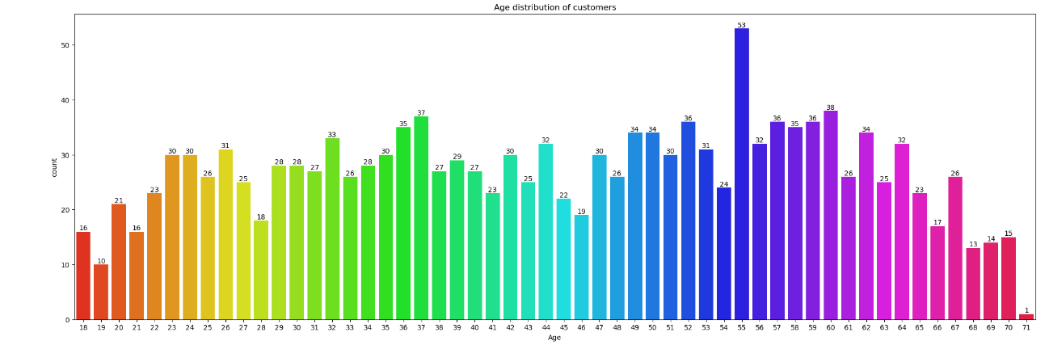

Slide 6
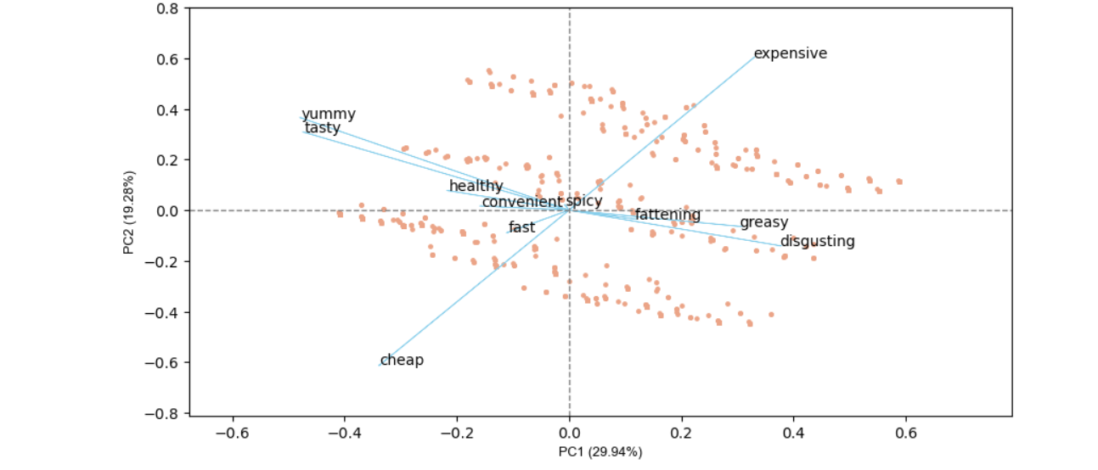

Slide 7

Thank You ☺
Github link:- https://github.com/kantana29/McDonalds

